Slide 1
Disclaimer
Thank you for your interest in using Google Cloud training material. We are excited about the content we are able to provide you (collectively, “Teaching Resources”) and hope you are too.
By using Teaching Resources, you agree to be bound by all of the following terms, as well as the Google terms of service and the Google privacy policy. Unless otherwise specified, terms used below will have the meanings described in the Google terms of service.
Educational Use Only. Teaching Resources is intended only for use teaching courses at regionally accredited or higher learning institutions. The content may be adapted, customize, remixed, and shared for educational use. Content may not be distributed, or otherwise exploited for any commercial purpose, commercial advantage, or private monetary compensation.
Attribution Requirements. If you distribute, publicly perform, display, transmit, publish, or otherwise make available any Teaching Resources or any derivative works thereof, you must attribute the material you use back to the Teaching Resources, but not in any way that suggests Google, any of its affiliates, or any of its third party content providers endorse you or your use of such materials. If you adapt, remix, or customize the Teaching Resources please include the following text on each edited slide: “The original content was provided by Google LLC and modified for the purpose of the course, without input or endorsement from Google LLC.”
Descriptions of Google products, services, infrastructure and processes contained in the Teaching Resources are descriptions for teaching and learning purposes only and do not constitute a guarantee, promise, or representation of accuracy by Google. Pricing, availability or features of Google Cloud products and services described in the Teaching Resources may change.
Copyright Google LLC. For educational purposes in accordance with the terms of use set forth on the program Website.

Slide 2
Use Google Cloud to Build Your Apps
Copyright Google LLC. For educational purposes in accordance with the terms of use set forth on the program Website.
Notes:
Welcome to Use Google Cloud to Build Your Apps, I’m ______. In this module we’ll focus on leveraging Google Cloud resources and serverless managed services to build applications

Slide 3
Course map
Module 1
Module 2
Module 3
Module 4
Module 5
So, What’s the Cloud Anyway?
Start with a Solid Platform
Use Google Cloud to Build Your Apps
Where Do I Store This Stuff?
There’s an API for That!
Module 6
Module 7
Module 8
Module 9
Module 10
You Can’t Secure the Cloud, Right?
It Helps to Network
Let Google Keep an Eye on Things
You Have the Data, but What Are You Doing with It?
Let Machines Do the Work
Google Cloud skills badges
Copyright Google LLC. For educational purposes in accordance with the terms of use set forth on the program Website.
Notes:
So far in this course, we’ve learned what Google Cloud is, and found out why we should have a solid platform before beginning a Google Cloud transfer. In this module, we’ll learn how to build apps directly in Google Cloud.

Slide 4

Learn how to ... (1/2)
Discover the different compute options in Google Cloud
Explore the role of compute options in the cloud
Describe building and managing virtual machines
Explain building elastic applications using autoscaling
Explore PaaS options by leveraging App Engine
Copyright Google LLC. For educational purposes in accordance with the terms of use set forth on the program Website.
Notes:
The objective of this module is for you to be able to discover the different compute options in Google Cloud.
The specific learning objectives to achieve this include you being able to discuss the role of compute options in the cloud, describe building and managing virtual machines, explain building elastic applications using autoscaling, and explore PaaS options by leveraging App Engine.

Slide 5
Learn how to ... (2/2)
Discuss building event-driven services utilizing Cloud Functions
Explain containerizing and orchestrating applications with Google Kubernetes Engine
Copyright Google LLC. For educational purposes in accordance with the terms of use set forth on the program Website.
Notes:
You’ll also be able to discuss building event-driven services utilizing Cloud Functions, as well as explain containerizing and orchestrating applications with Google Kubernetes Engine, also referred to as GKE.

Slide 6
Agenda (1/3)
Compute Options in the Cloud
Exploring IaaS with Compute Engine
Lab: Creating a Virtual Machine
Configuring Elastic Apps with Autoscaling
Exploring PaaS with App Engine
Lab: App Engine: Qwik Start - Python
Copyright Google LLC. For educational purposes in accordance with the terms of use set forth on the program Website.
Notes:
This agenda shows the topics that make up the module. We’ll start by learning about compute options in the cloud. We’ll then move on to finding out how to build and deploy apps using Compute Engine and how to create a Virtual Machine by completing a hands-on lab. We’ll then discover how to configure elastic apps with autoscaling, and explore how App Engine can run your applications without having you manage the infrastructure. The second lab of the module will see us creating a small App Engine application that displays a short message.

Slide 7
Agenda (2/3)
Event Driven Programs with Cloud Functions
Lab: Cloud Functions: Qwik Start - Command Line
Containerizing and Orchestrating Apps with GKE
Lab: Kubernetes Engine: Qwik Start
Copyright Google LLC. For educational purposes in accordance with the terms of use set forth on the program Website.
Notes:
We’ll then move on to finding out about event driven programs with Cloud Functions and complete a lab where we’ll create, deploy, and test a cloud function using the Cloud Shell command line. We’ll finish the module learning about containerizing and orchestrating apps with Google Kubernetes Engine and get hands on practice with container creation and application deployment.

Slide 8
Agenda (3/3)
Lab: Set Up Network and HTTP Load Balancers
Quiz
Summary
Copyright Google LLC. For educational purposes in accordance with the terms of use set forth on the program Website.
Notes:
The final lab of the module will show you the differences between a network load balancer and a HTTP load balancer, and how to set them up for your applications running on Google Compute Engine virtual machines.

Slide 9
Agenda
Compute Options in the Cloud
Exploring IaaS with Compute Engine
Lab: Creating a Virtual Machine
Configuring Elastic Apps with Autoscaling
Exploring PaaS with App Engine
Lab: App Engine: Qwik Start - Python
Copyright Google LLC. For educational purposes in accordance with the terms of use set forth on the program Website.
Notes:
Let’s start with the first topic, compute options in the cloud.

Slide 10
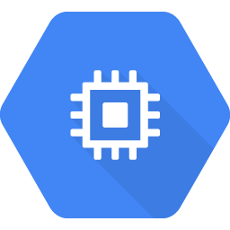
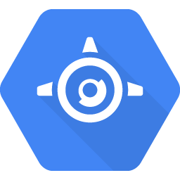
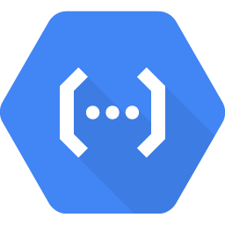
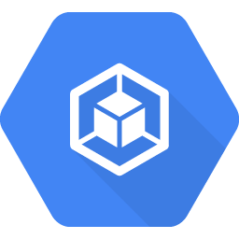
Google Cloud offers a variety of compute services spanning different usage options
Compute Engine
App Engine
Cloud Functions
Google Kubernetes Engine
IaaS
PaaS
Serverless logic
Hybrid
Virtual machines with industry-leading price/performance
A flexible, zero ops platform for building highly available apps
A lightweight fully managed serverless execution environment for building and connecting cloud services
Cluster manager and orchestration engine built on Google’s container experience
Copyright Google LLC. For educational purposes in accordance with the terms of use set forth on the program Website.
Notes:
For general workloads that require dedicated resources for your applications, Compute Engine is a good option. If you’re looking for a platform as a service, App Engine is a good option. Cloud Functions offers a serverless option for triggering code to run based on some kind of event. To run containers on a managed Kubernetes platform, you can leverage GKE.
We’ll discuss each of these compute services during this module.

Slide 11
Agenda
Compute Options in the Cloud
Exploring IaaS with Compute Engine
Lab: Creating a Virtual Machine
Configuring Elastic Apps with Autoscaling
Exploring PaaS with App Engine
Lab: App Engine: Qwik Start - Python
Copyright Google LLC. For educational purposes in accordance with the terms of use set forth on the program Website.
Notes:
Next, we’ll discover how to build and deploy applications with Compute Engine.

Slide 12
Where Compute Engine fits within Google Cloud
Compute Engine
App Engine
Cloud Functions
Google Kubernetes Engine
IaaS
PaaS
Serverless logic
Hybrid
Virtual machines with industry-leading price/performance
A flexible, zero ops platform for building highly available apps
A lightweight fully managed serverless execution environment for building and connecting cloud services
Cluster manager and orchestration engine built on Google’s container experience
Copyright Google LLC. For educational purposes in accordance with the terms of use set forth on the program Website.
Notes:
Compute Engine delivers virtual machines running in Google's innovative data centers and worldwide fiber network.
Compute Engine is ideal if you need complete control over the virtual-machine infrastructure, need to make changes to the kernel, such as providing your own network or graphics drivers to squeeze out the last drop of performance, or if you need to run a software package that can’t easily be containerized or have existing VM images to move to the cloud.

Slide 13
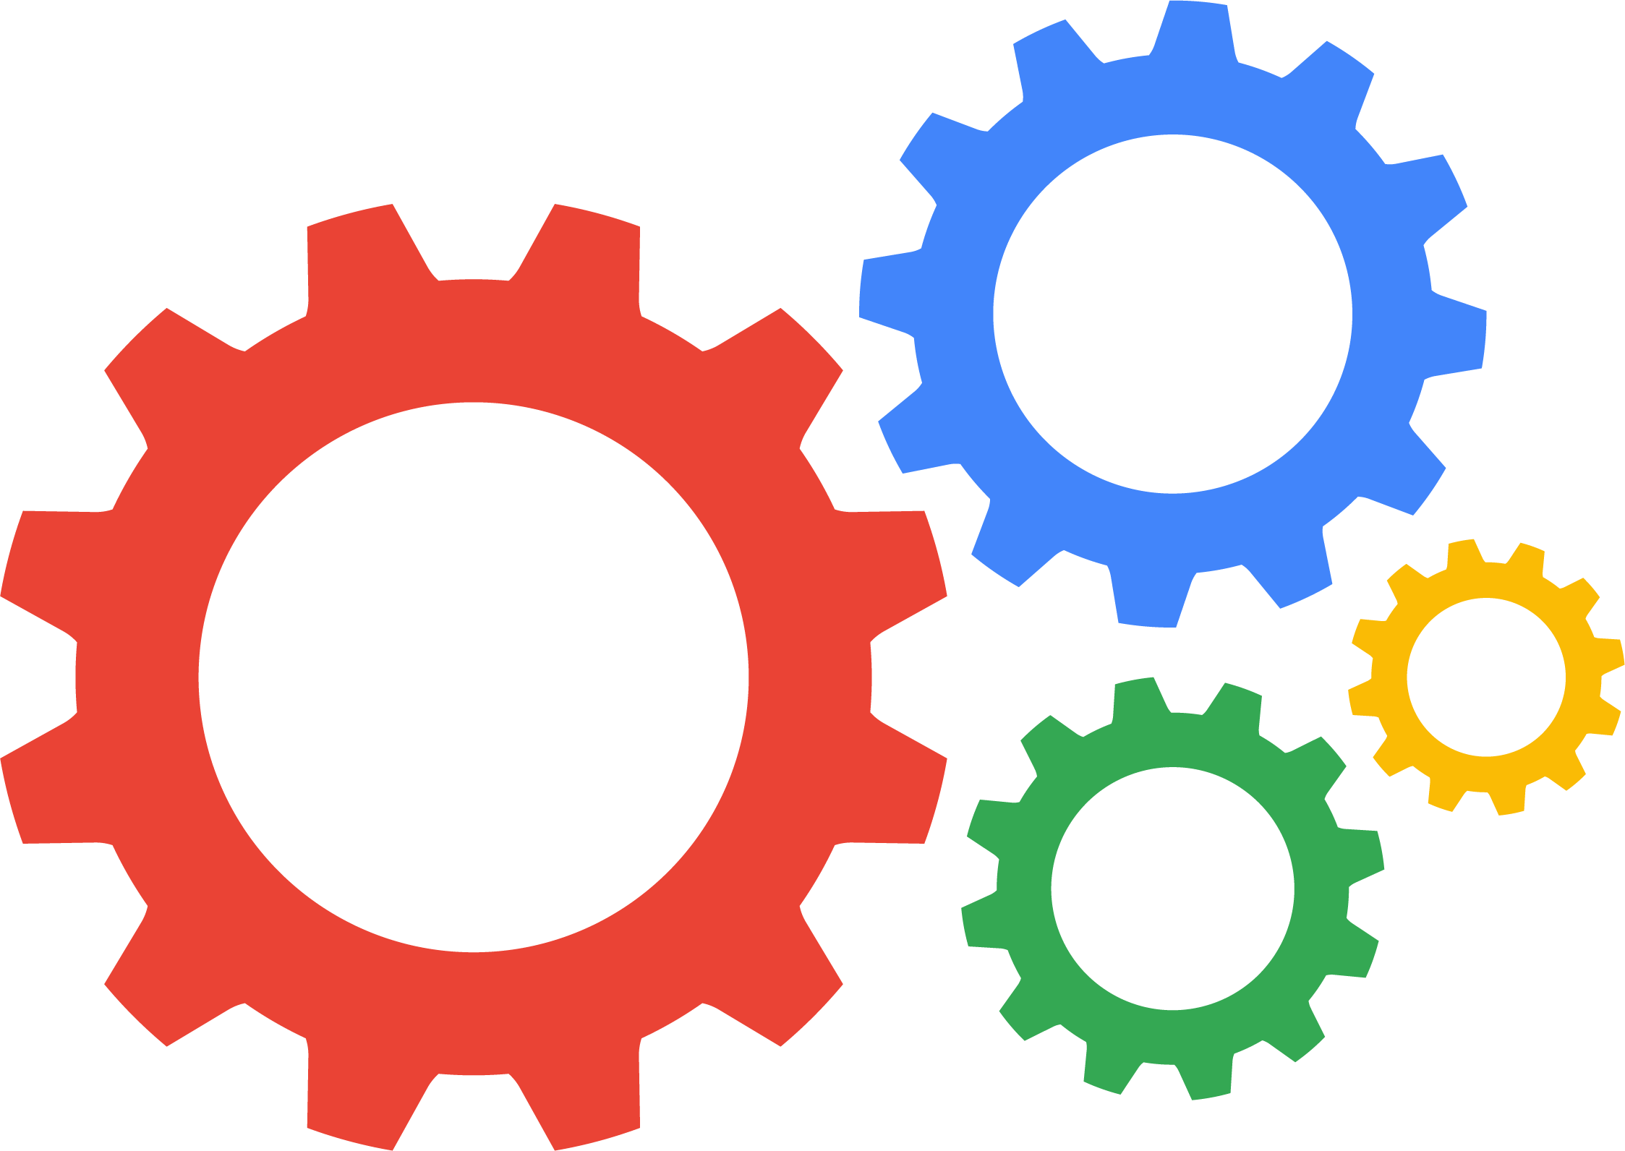
Compute Engine is an infrastructure-centric solution
Type of IaaS
Scalable, high-performance VMs
Run any computing workload
Predefined or custom machine types
Windows or Linux
No upfront investment required
Copyright Google LLC. For educational purposes in accordance with the terms of use set forth on the program Website.
Notes:
Compute Engine is a type of infrastructure as a service, delivering scalable, high-performance virtual machines running on Google’s infrastructure. Compute Engine VMs boot quickly, come with persistent disk storage, and deliver consistent performance.
You can run any computing workload on Compute Engine, such as, web-server hosting, application hosting, and/or application backends.
Virtual servers are available in many configurations, including predefined sizes. Alternatively, there’s the option to create custom machine types optimized for specific needs.
Compute Engine also allows users to run their choice of operating system.
While Compute Engine allows users to run thousands of virtual CPUs on a system that has been designed to be fast and offer strong performance consistency, there’s no upfront investment required!

Slide 14
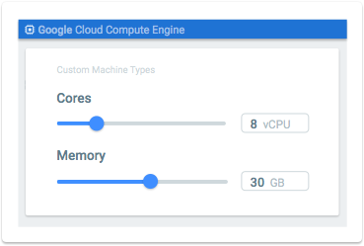
Create VMs that are right for your workloads
Machine type options to consider:
Higher proportion of memory to CPU
Higher proportion of CPU to memory
Blend of both
Select from predefined VM configurations:
General-purpose
Memory-optimized
Compute-optimized
Customize your own configuration
Copyright Google LLC. For educational purposes in accordance with the terms of use set forth on the program Website.
Notes:
The purpose of custom virtual machines is to ensure you can create virtual services with just enough resources to work for your application. For example, you want to run your application on a virtual machine, but none of the pre-defined versions will fit the resource footprint you require, or your application needs to run on a specific CPU architecture, or GPUs are required to run your application. Custom virtual machines allow for creating a perfect fit for your applications.
To meet your workload requirements, there are different machine type options that you can consider. A higher proportion of memory to CPU, a higher proportion of CPU to memory, or a blend of both through Google’s standard configuration.
Compute Engine offers predefined machine types that you can use when you create an instance. A predefined machine type has a preset number of vCPUs and amount of memory, and are charged at a set price. You can choose from general-purpose machine types, memory-optimized machine types, and compute-optimized machine types. Predefined virtual machine configurations range from micro instances of 2 vCPU and 8 GB of memory to memory-optimized instances with up to 160 vCPUs and 3.75 TB of memory.
Compute Engine also allows you to create virtual machines with the vCPU and memory that meet workload requirements. Besides the performance benefits of doing so, this also allows you to significantly reduce costs. You can create a machine type with as little as 1 vCPU and up to 80 vCPUs, or any even number of vCPUs in between. You can configure up to 8 GB of memory per vCPU.

Slide 15
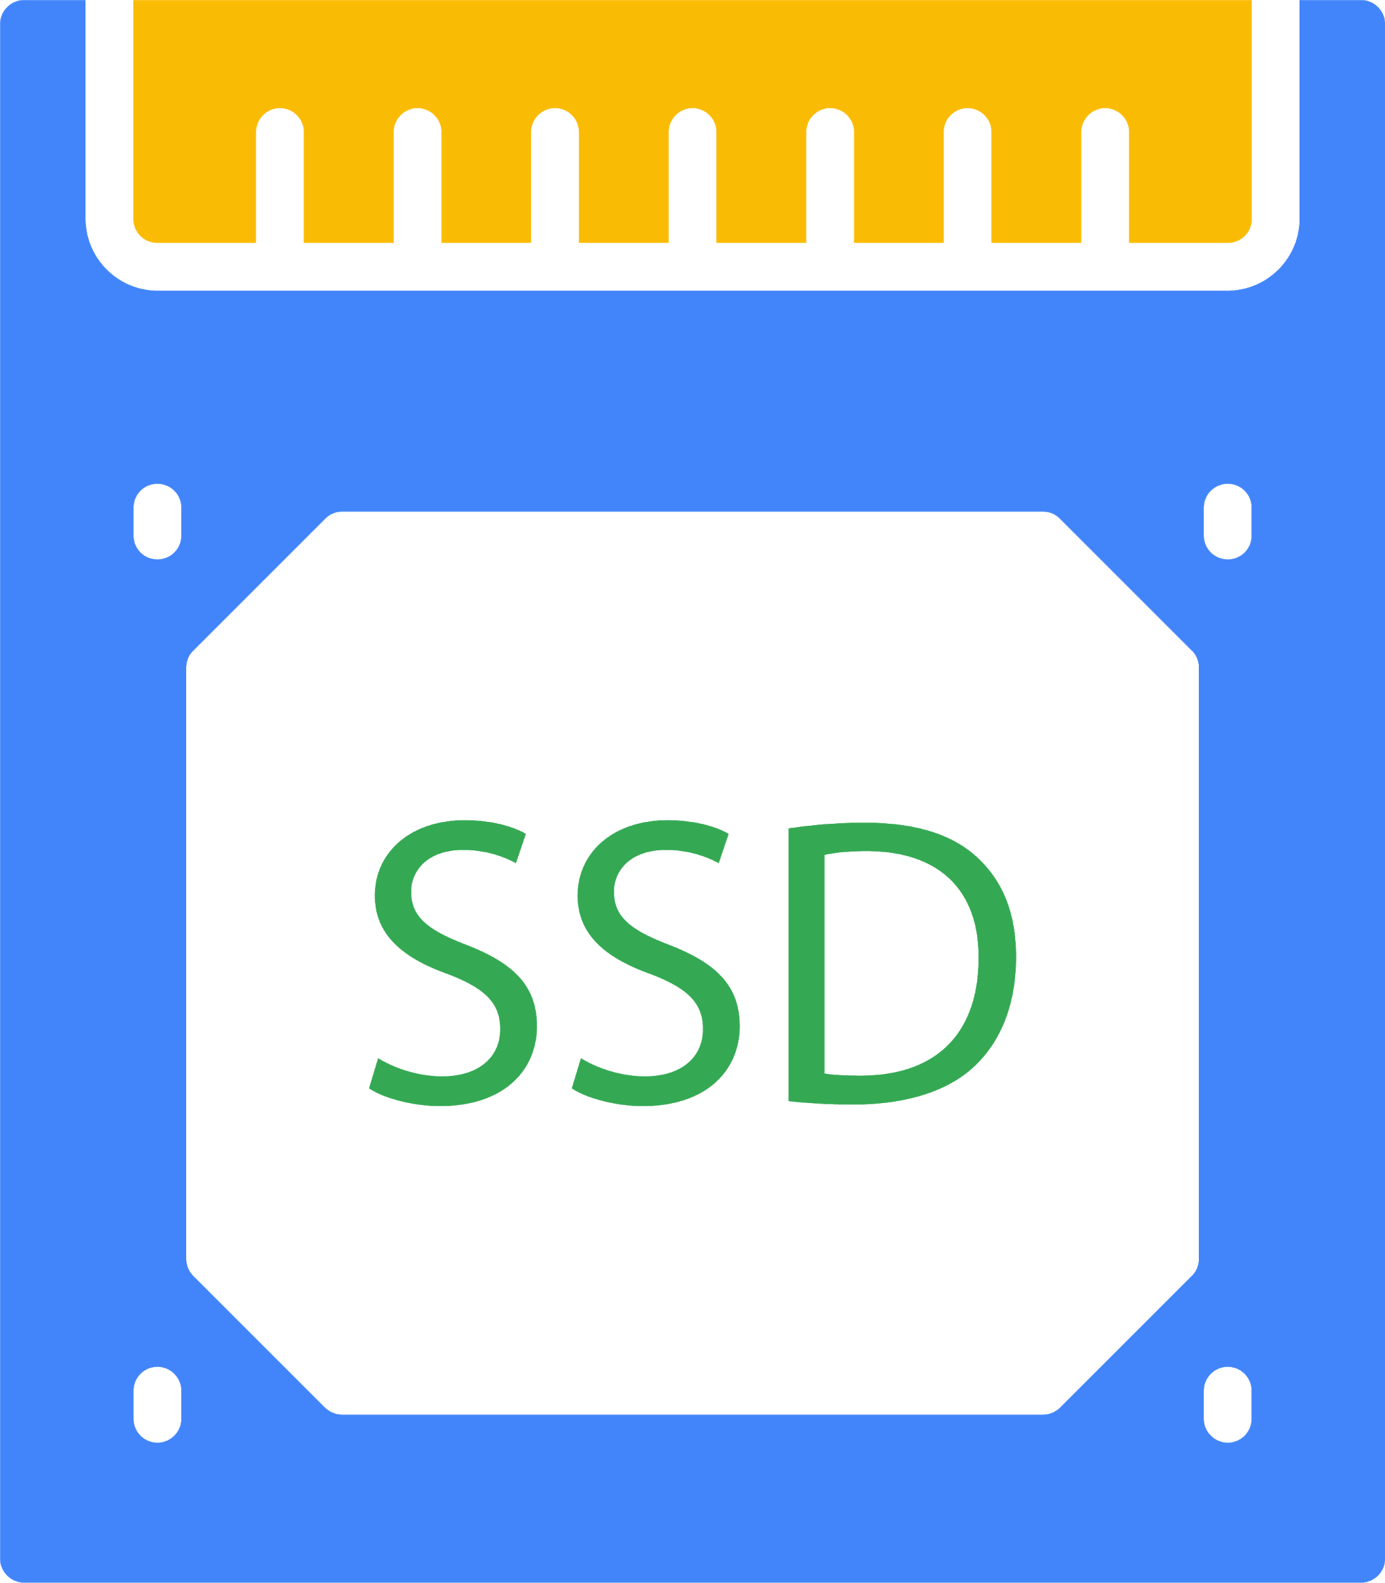
Building virtual disks
Network storage can be attached to VMs as persistent disks (PDs).
PDs are cost-effective, durable, and offer good performance.
Local SSDs provide higher performance with lower latency, but exist only for the lifetime of a specific instance.
Standard PD throughput performance and IOPS increases linearly with the size of the disk until it reaches set per-instance limits.
SSD PD IOPS performance depends on the number of vCPUs in the instance in addition to disk size.
Copyright Google LLC. For educational purposes in accordance with the terms of use set forth on the program Website.
Notes:
Network storage, up to 64 TB in size, can be attached to VMs as persistent disks. Persistent disks are the most common storage option due to their price, performance, and durability, and can be created in HDD or SSD formats. If a VM instance is terminated, its persistent disk retains data and can be attached to another instance. You can also take snapshots of your persistent disk and create new persistent disks from that snapshot.
Compute Engine offers always-encrypted local SSD block storage. Unlike standard persistent disks, local SSDs are physically attached to the server hosting the VM instance offering very high input/output operations per second and very low latency compared to persistent disks. Predefined local SSD sizes up to 3TB are available for any VM with at least 1 vCPU. By default, most Compute Engine-provided Linux images will automatically run an optimization script that configures the instance for peak local SSD performance.
Standard persistent disk performance scales linearly up to the VM performance limits. A vCPU count of 4 or more for your instance doesn’t limit the performance of standard persistent disks. A vCPU count of less than 4 for an instance reduces the write limit for input/output operations per second, or IOPS, because network egress limits are proportional to the vCPU count. The write limit also depends on the size of I/Os, for example, 16 KB I/Os consume more bandwidth than 8 KB I/Os at the same IOPS level. Standard persistent disk IOPS and throughput performance increases linearly with the size of the disk until it reaches set per-instance limits.
The IOPS performance of SSD persistent disks depends on the number of vCPUs in the instance in addition to disk size. Lower core VMs have lower write IOPS and throughput limits due to network egress limitations on write throughput. SSD persistent disk performance scales linearly until it reaches either the limits of the volume or the limits of each Compute Engine instance. SSD read bandwidth and IOPS consistency near the maximum limits largely depends on network ingress utilization; some variability is to be expected, especially for 16 KB I/Os near the maximum IOPS limits.
-------------------------------------------
Specific limits can be viewed at this source: https://cloud.google.com/compute/docs/disks/performance#size_price_performance

Slide 16
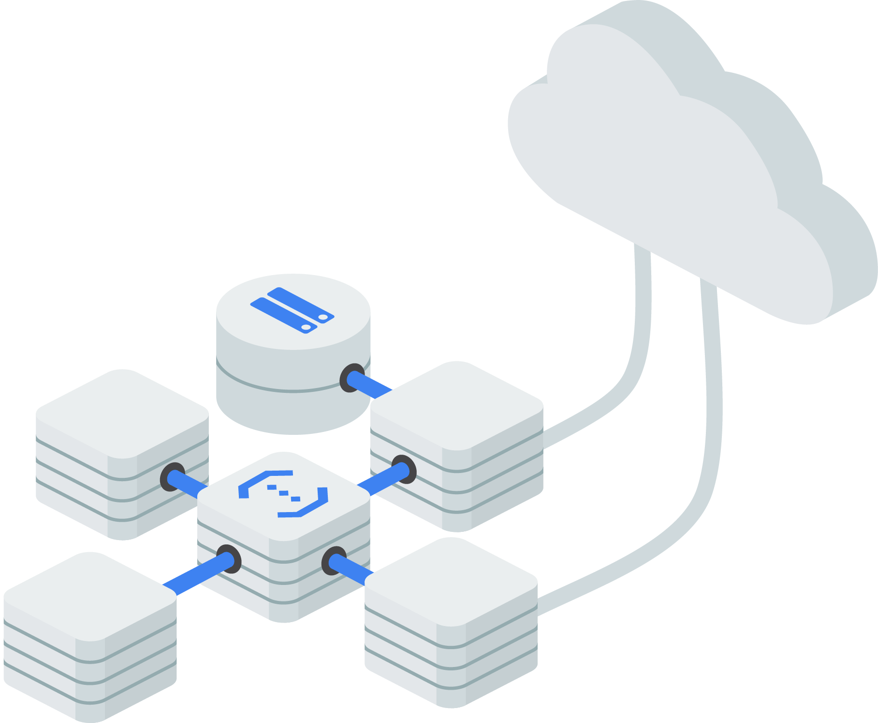
Networks connect Compute Engine instances to each other and to the internet
Inbound/outbound firewall rules
Create static routes
Scale and distribute applications using Cloud Load Balancing
Global and multi-regional subnetwork
Copyright Google LLC. For educational purposes in accordance with the terms of use set forth on the program Website.
Notes:
Networks in the cloud have a lot of similarities with physical networks.
You can segment networks, use firewall rules to restrict access to instances, and create static routes to forward traffic to specific destinations.
You can scale applications on Compute Engine from zero to full throttle with Cloud Load Balancing. Distribute your load-balanced compute resources in single or multiple regions close to your users and to meet your high availability requirements.
Subnetworks segments your cloud network IP space into subnetworks. Subnetwork prefixes can be automatically allocated, or you can create a custom topology.
When you build a Compute Engine instance, you use a virtual network adapter, that is part of the instance, to connect a virtual machine to a network, much in the same way you would connect a physical server to a network. For Compute Engine, you can have up to 8 virtual adapters.
Subnetworks and Cloud Load Balancing are both discussed in the module It Helps to Network.

Slide 17
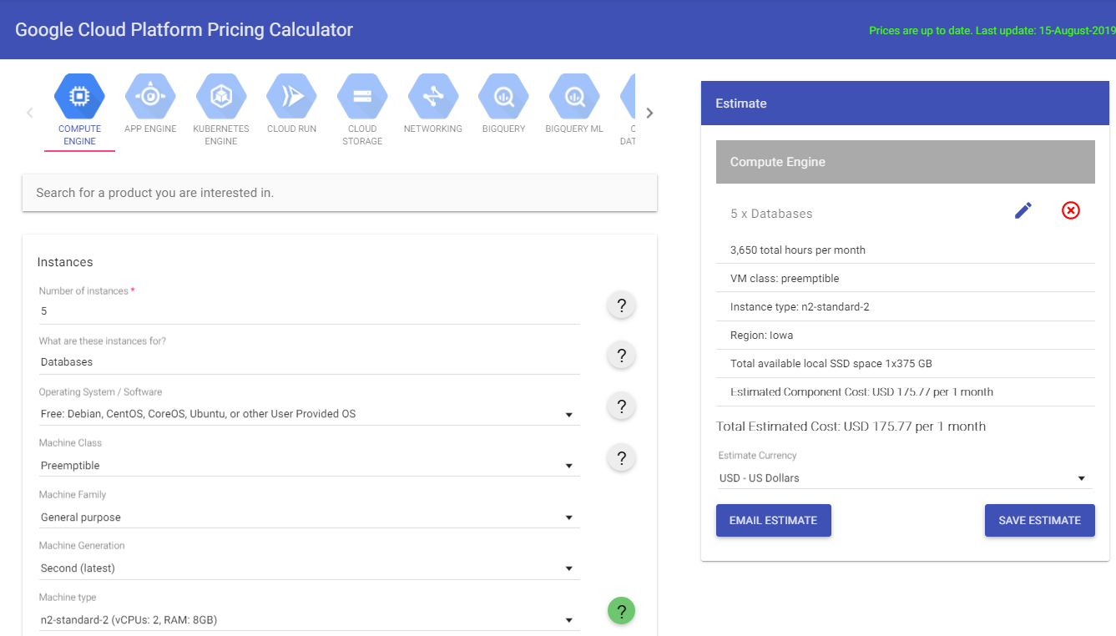
Compute Engine pricing
https://cloud.google.com/products/calculator/
Copyright Google LLC. For educational purposes in accordance with the terms of use set forth on the program Website.
Notes:
All virtual machines are charged for 1 minute at boot time, which is the minimum charge for a VM. After that, per-second pricing begins, meaning that you only pay for the compute time used. Google also offer sustained use discounts, which automatically provide discounted prices for long-running workloads without the need for sign-up fees or any up-front commitment. Predefined machine types are discounted based on the percent of monthly use, while custom machine types are discounted on a percent of total use.
The Google Cloud Pricing Calculator is a great way to see pricing estimates based on the different configuration options that are available under instances, sole-tenant nodes, persistent disks, load balancing, and cloud TPUs.
-------------------------------
Source: Google Cloud Pricing Calculator: https://cloud.google.com/products/calculator/

Slide 18
Agenda
Compute Options in the Cloud
Exploring IaaS with Compute Engine
Lab: Creating a Virtual Machine
Configuring Elastic Apps with Autoscaling
Exploring PaaS with App Engine
Lab: App Engine: Qwik Start - Python
Copyright Google LLC. For educational purposes in accordance with the terms of use set forth on the program Website.
Notes:
Next, we’ll create a virtual machine in the lab.

Slide 19
Lab Intro
Creating a Virtual Machine
Create virtual machine instances of various machine types using the Cloud Console and the gcloud command line then connect an NGINX web server to your virtual machine.
You can find the lab here.
Copyright Google LLC. For educational purposes in accordance with the terms of use set forth on the program Website.
Notes:
In this lab, we’ll create virtual machine instances of various machine types using the Cloud Console and the gcloud command line then connect an NGINX web server to your virtual machine.

Slide 20
Lab objectives
Create a virtual machine with the Cloud Console.
Create a virtual machine with gcloud command line.
Deploy a web server and connect it to a virtual machine.
Copyright Google LLC. For educational purposes in accordance with the terms of use set forth on the program Website.
Notes:
By completing the lab, you’ll create a virtual machine with the Cloud Console, create a virtual machine using the gcloud command line, and deploy a web server and connect it to a virtual machine.

Slide 21
Lab Intro
Compute Engine: Qwik Start - Windows (Alternative)
Launch a Windows Server instance in Compute Engine, and connect to it using the Remote Desktop Protocol.
You can find the lab here.
Copyright Google LLC. For educational purposes in accordance with the terms of use set forth on the program Website.
Notes:
In this lab, we’ll launch a Windows Server instance in Compute Engine, and connect to it using the Remote Desktop Protocol.

Slide 22
Lab objectives
Create a virtual machine instance.
Test the status of Windows Startup.
Connect to your instance.
Remote desktop into the Windows server.
Copy and paste with the remote desktop client.
Copyright Google LLC. For educational purposes in accordance with the terms of use set forth on the program Website.
Notes:
By completing the lab, you’ll create a virtual machine instance, test the status of Windows Startup, connect to your instance, remote desktop into the Windows server, and copy and paste with the remote desktop client.

Slide 23
Agenda
Compute Options in the Cloud
Exploring IaaS with Compute Engine
Lab: Creating a Virtual Machine
Configuring Elastic Apps with Autoscaling
Exploring PaaS with App Engine
Lab: App Engine: Qwik Start - Python
Copyright Google LLC. For educational purposes in accordance with the terms of use set forth on the program Website.
Notes:
Our next topic looks at building elastic applications with autoscaling.

Slide 24

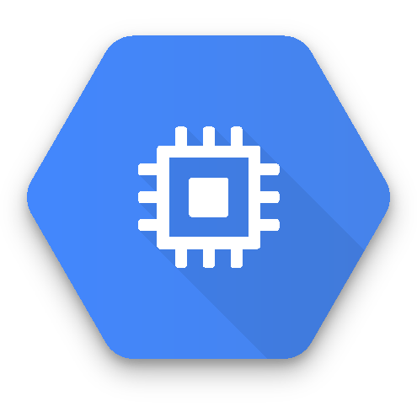


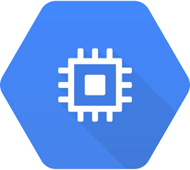
How autoscaling works
Startup and shutdown scripts
Cloud Storage
n
Autoscaler
Instructs managed instance group
Instance group
OS image
Template
Resources
Image services
Compute Engine
Copyright Google LLC. For educational purposes in accordance with the terms of use set forth on the program Website.
Notes:
Let’s look at how autoscaling works.
Autoscaler controls managed instance groups, adding and removing instances using policies. A policy includes the minimum and maximum number of replicas.
In this diagram, n is any number of instance replicas based on a template. The template requisitions resources from Compute Engine, identifies an OS image to boot, and starts new VMs.
Startup and shutdown scripts can be used for many purposes. However, in cases where speed of autoscaling is required, it is a common practice to "bake" customizations and software installation into the OS Image, and use scripts for graceful entry and exit. For example, a shutdown script can be used to notify a load balancer that the instance is going out of service, and not to send any more traffic.

Slide 25
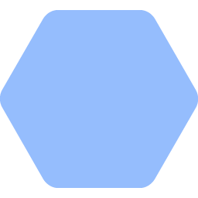
Scale-out policy decision
managed instance group
100%
100%
100%
85%
100%
100%
100%
85%
Target CPU utilization = 0.75
Actual utilization = 385/400 = 96.25%
If +1 then 385/500 = 77% (Still above target 75%)
If +2 then 385/600 = 64.16%
Copyright Google LLC. For educational purposes in accordance with the terms of use set forth on the program Website.
Notes:
The percentage utilization that an additional VM contributes depends on the size of the group. The 4th VM added to a group offers 25% increase in capacity to the group. The 10th VM added to a group only offers 10% more capacity, even though the VMs are the same size.
In this case shown in the diagram Autoscaler is conservative and rounds up. In other words, it would prefer to start an extra VM that isn't really needed than to possibly run out of capacity,

Slide 26
Scale-in policy decision
managed instance group
80%
55%
40%
36%
73%
46%
Target CPU utilization = 0.75
Actual utilization = 330/600 = 55%
If -1 then 330/500 = 66% (Still below target)
If -2 then 330/400 = 82.5%
Copyright Google LLC. For educational purposes in accordance with the terms of use set forth on the program Website.
Notes:
In this example, removing one VM doesn't get close enough to the target of 75%. Removing a second VM would exceed the target. Autoscaler behaves conservatively. So it will shut down one VM rather than two VMs. It would prefer underutilization over running out of resource when it is needed.

Slide 27
Agenda
Compute Options in the Cloud
Exploring IaaS with Compute Engine
Lab: Creating a Virtual Machine
Configuring Elastic Apps with Autoscaling
Exploring PaaS with App Engine
Lab: App Engine: Qwik Start - Python
Copyright Google LLC. For educational purposes in accordance with the terms of use set forth on the program Website.
Notes:
Next, we’ll explore how App Engine can run your applications without having you manage the infrastructure.

Slide 28
Where App Engine fits within Google Cloud
Compute Engine
App Engine
Cloud Functions
Google Kubernetes Engine
IaaS
PaaS
Serverless logic
Hybrid
Virtual machines with industry-leading price/performance
A flexible, zero ops platform for building highly available apps
A lightweight fully managed serverless execution environment for building and connecting cloud services
Cluster manager and orchestration engine built on Google’s container experience
Copyright Google LLC. For educational purposes in accordance with the terms of use set forth on the program Website.
Notes:
App Engine allows you to build highly scalable applications on a fully managed, serverless platform.
App Engine is ideal if time-to-market is highly valuable to you and you want to be able to focus on writing code without ever having to touch a server, cluster, or infrastructure. It’s also ideal if you don’t want to worry about a pager going off or receiving 5xx errors! App Engine allows you to have high availability apps without a complex architecture.

Slide 29
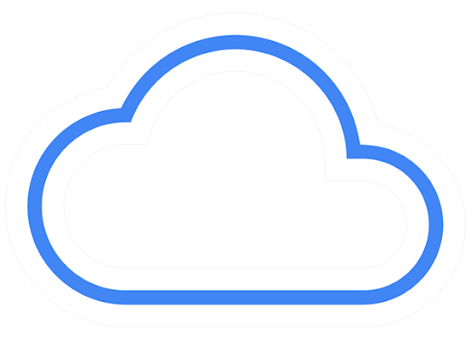
App Engine is a platform-centric solution
Type of PaaS
No need to buy, build, or operate hardware/infrastructure
No managing servers or configuring deployments
Focus on app development instead of operations
Use a range of languages and tools
Automatic scaling
Copyright Google LLC. For educational purposes in accordance with the terms of use set forth on the program Website.
Notes:
As a fully managed environment, App Engine is the perfect example of a computing platform provided as a service.
App Engine can save organizations time and cost in software application development by eliminating the need to buy, build, and operate computing hardware and other infrastructure. This includes no server management and no need to configure deployments. This allows engineering teams to focus on creating high-value applications, instead of no-value operations work.
You can quickly build and deploy applications using a range of popular languages like Java, PHP, Node.js, Python, C#, .Net, Ruby and Go, or you can bring your own language runtimes and frameworks. App Engine allows you to manage resources from the command line, debug source code in production, and run API backends easily using industry leading tools such as the Cloud SDK, Cloud Source Repositories, IntelliJ IDEA, Visual Studio, and PowerShell.
App Engine automatically scales depending on the application traffic and consumes resources only when code is running. This allows costs to be kept to a minimum.

Slide 30
App Engine offers two different environments
Standard environment
Flexible environment
Fully-managed
Scale to zero
Specific versions of supported languages
Changes/configuration limited
Docker container support
VMs exposed
Any language in your container
More options for infrastructure customization and configuration for performance
Copyright Google LLC. For educational purposes in accordance with the terms of use set forth on the program Website.
Notes:
You can run your applications in App Engine using a standard or flexible environment. You can also choose to simultaneously use both environments and allow your services to take advantage of each environment's individual benefits.
The standard environment offers a fully managed infrastructure for your application that can scale down to zero if not in use. This means you stop paying to use the service. However, your applications must conform to the docked-down environment of App Engine Standard. Only the specific version of a few runtimes is supported. You cannot log into the system to make changes, you cannot write to persistent disk, and the configuration of the environment is limited.
App Engine Flexible runs your application in a Docker container environment. You can use any HTTP-based runtime. The virtual machines are exposed, allowing you to log into them and write to persistent disks. However, the system will not scale to zero. You will still pay for the service even if users aren’t using your application. Because VM instances in the flexible environment are Compute Engine virtual machines, there are far more options for infrastructure customization. You are also able to take advantage of a wide array of CPU and memory configurations.
In summary, if you just need a high-performance, managed infrastructure and can conform to the strict runtime limitations, then App Engine Standard is a great option. If you need to use custom runtimes, or if you need a less rigid environment but still want to leverage a PaaS, then App Engine Flexible would be a more suitable option.
----------------------------------------------------------
Further information on comparing high-level features: https://cloud.google.com/appengine/docs/the-appengine-environments#comparing_high-level_features

Slide 31
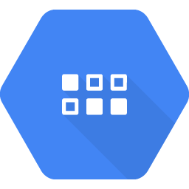

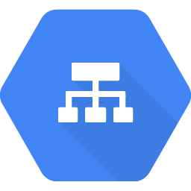
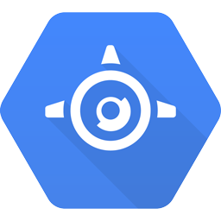
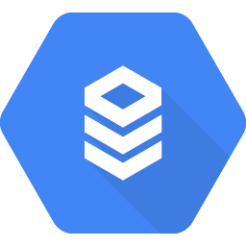


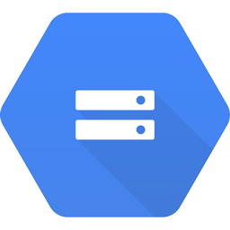

An App Engine architecture example
dynamic storage
Front end application
Batch
application
Datastore
Cloud Load Balancing
App Engine
Front end
App Engine
Back end
Cloud SQL
Memcache
Cloud Storage
Task Queues
static storage
Copyright Google LLC. For educational purposes in accordance with the terms of use set forth on the program Website.
Notes:
The front end is often critical to the user experience. To ensure consistent performance, the built in load balancer will distribute traffic to multiple front ends and scale the front end as necessary. The back end is for more intensive processing. This separation of function allows each part to scale as needed.
Note that the App Engine service is modular and this example shows a single service. More complex architectures are possible.

Slide 32
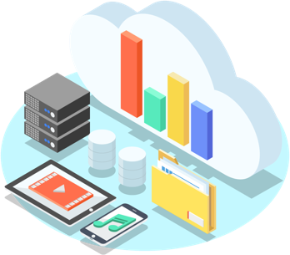
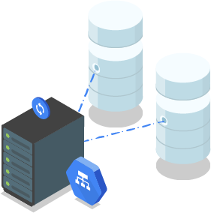
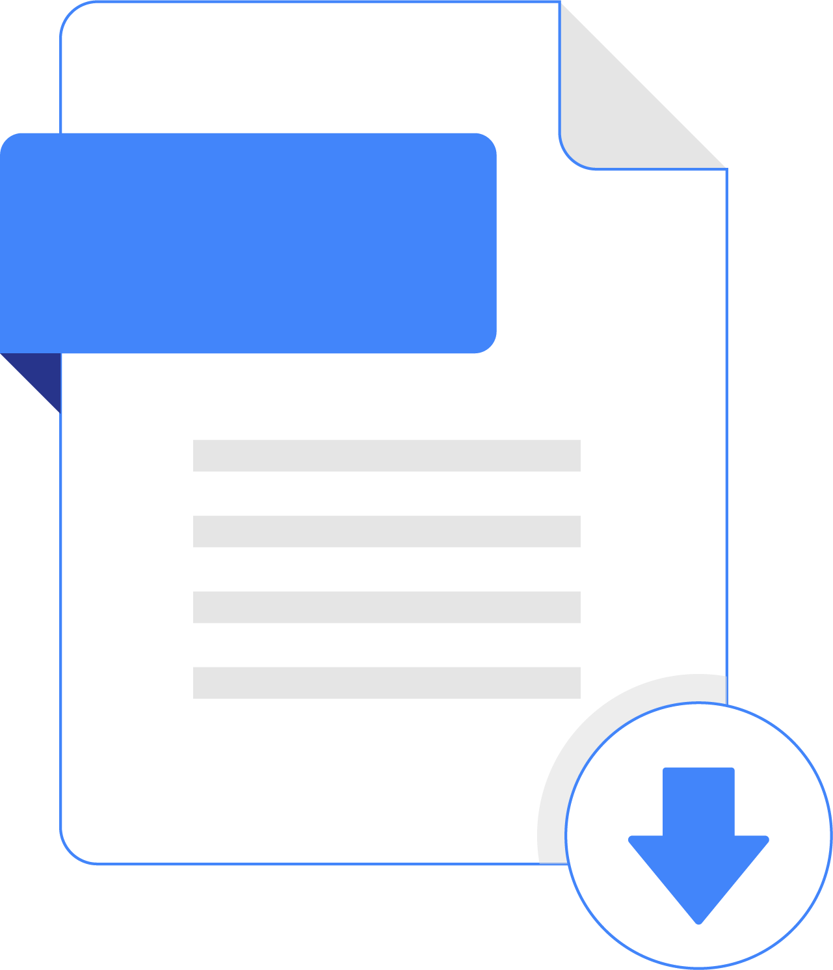
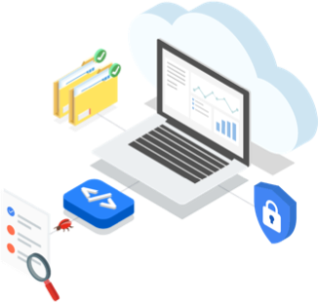


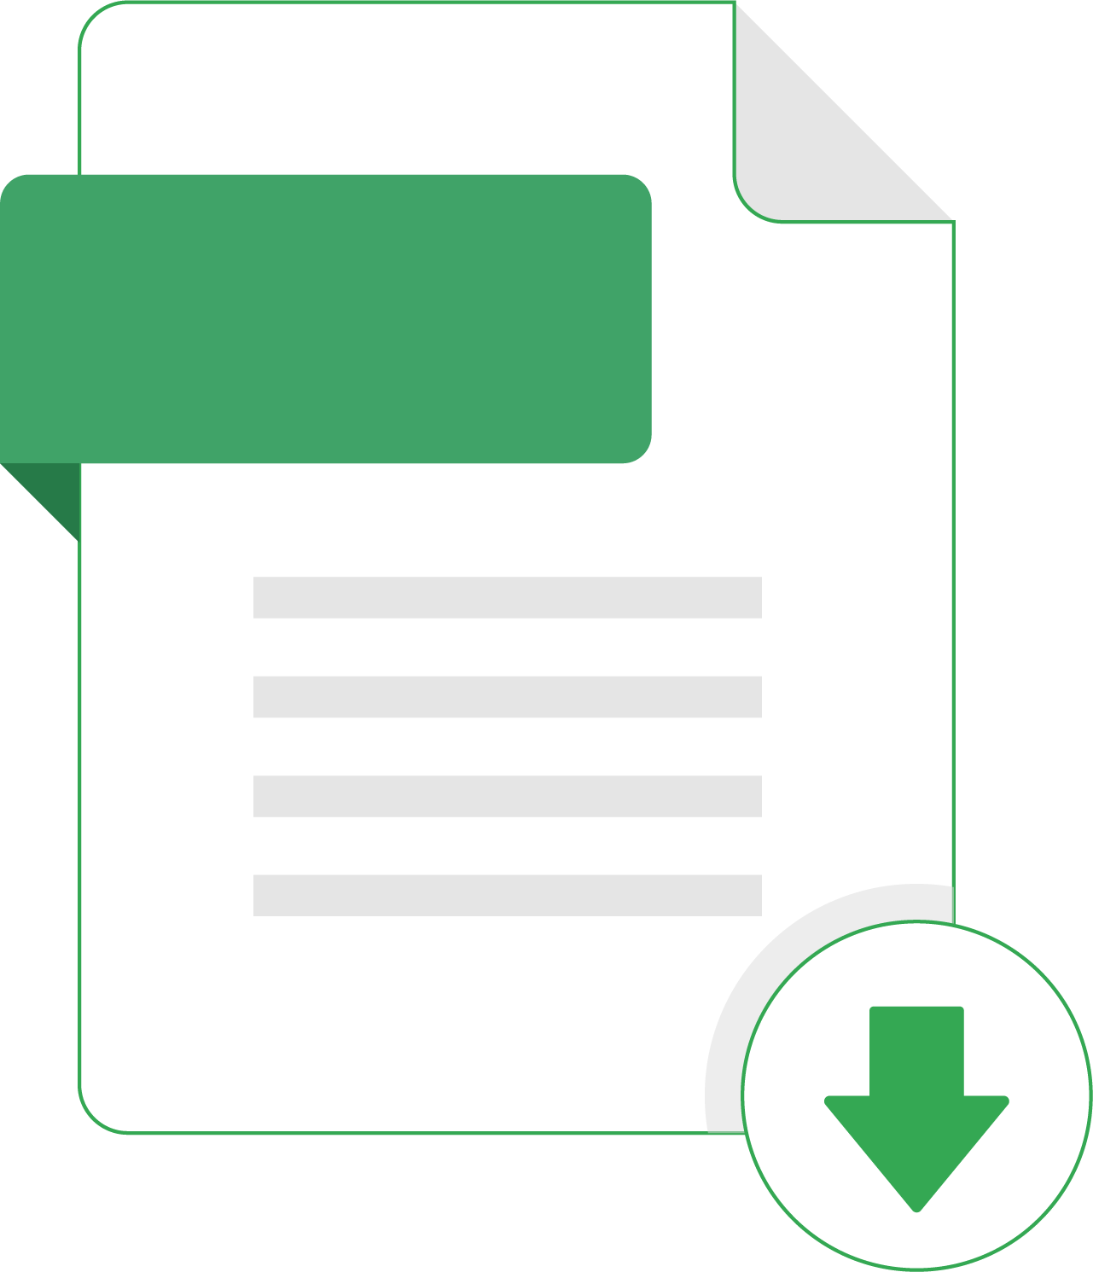
App Engine addresses the key needs of developers
Multiple storage options
Automatic scaling
Load balancing
V1.1
V1.2
V1.3
App versioning
Monitoring and logging
Security
Copyright Google LLC. For educational purposes in accordance with the terms of use set forth on the program Website.
Notes:
When using App Engine, you also have multiple options to store application data, including caching through App Engine memcache, Cloud Storage for any objects up to 5 TB in size, Datastore for persistent, low-latency memory for serving data to applications, Cloud SQL, which is a relational database that can be run on a persistent disk greater than 1 terabyte in size, and Cloud Bigtable, which is a NoSQL database for heavy read/writes and analysis.
The automatic scaling of App Engine allows you to meet any demand, and load balancing distributes load-balanced compute resources in single or multiple regions close to users to meet high availability requirements.
With App Engine you can easily host different versions of your app, which includes creating development, test, staging, and production environments.
Google Cloud’s operations suite gives you powerful application diagnostics to debug and monitor the health and performance of your app, and you can leverage robust security tools like Cloud Security Spanner.
All of this is provided with high availability and guaranteed redundancy.

Slide 33
Agenda
Compute Options in the Cloud
Exploring IaaS with Compute Engine
Lab: Creating a Virtual Machine
Configuring Elastic Apps with Autoscaling
Exploring PaaS with App Engine
Lab: App Engine: Qwik Start - Python
Copyright Google LLC. For educational purposes in accordance with the terms of use set forth on the program Website.
Notes:
Now we’ll deploy an application using App Engine through a hands-on lab.

Slide 34
Lab Intro
App Engine: Qwik Start - Python
Create a small App Engine application that displays a short message.
The lab can be found here.
Copyright Google LLC. For educational purposes in accordance with the terms of use set forth on the program Website.
Notes:
In this lab, we’ll create a small App Engine application that displays a short message.

Slide 35
Lab objectives
Download an application.
Test the application.
Deploy the application.
Copyright Google LLC. For educational purposes in accordance with the terms of use set forth on the program Website.
Notes:
By completing the lab, you’ll download an application, test the application, and deploy the application.

Slide 36
Lab Intro
Deploying a Python Flask Web Application to App Engine Flexible (Alternative)
Deploy a Python Flask web application to the App Engine Flexible environment.
The lab can be found here.
Copyright Google LLC. For educational purposes in accordance with the terms of use set forth on the program Website.
Notes:
In this lab, we’ll deploy a Python Flask web application to the App Engine Flexible environment.

Slide 37
Lab objectives
Deploy a simple web application to the App Engine flexible environment.
Access the Google Cloud client libraries for Vision, Storage, and Datastore.
Use the Cloud Shell.
Copyright Google LLC. For educational purposes in accordance with the terms of use set forth on the program Website.
Notes:
By completing the lab, you’ll deploy a simple web application to the App Engine flexible environment, access the Google Cloud client libraries for Vision, Storage, and Datastore, and use the Cloud Shell.

Slide 38
Agenda
Event Driven Programs with Cloud Functions
Lab: Cloud Functions: Qwik Start - Command Line
Containerizing and Orchestrating Apps with GKE
Lab: Kubernetes Engine: Qwik Start
Copyright Google LLC. For educational purposes in accordance with the terms of use set forth on the program Website.
Notes:
Cloud Functions is serverless code that allows you to run it based on certain events. We’ll learn how it works in this topic.

Slide 39
Where Cloud Functions fits within Google Cloud
Compute Engine
App Engine
Cloud Functions
Google Kubernetes Engine
IaaS
PaaS
Serverless logic
Hybrid
Virtual machines with industry-leading price/performance
A flexible, zero ops platform for building highly available apps
A lightweight fully managed serverless execution environment for building and connecting cloud services
Cluster manager and orchestration engine built on Google’s container experience
Copyright Google LLC. For educational purposes in accordance with the terms of use set forth on the program Website.
Notes:
Developer agility comes from building systems composed of small, independent units of functionality focused on doing one thing well. Cloud Functions lets users build and deploy services at the level of a single function, not at the level of entire applications, containers, or VMs.
Cloud Functions are ideal if you need to connect and extend cloud services and want to automate with event-driven functions that respond to cloud events. It’s also ideal if you want to use open and familiar Node.js, Python, or Go, while never managing a server or runtime environment.

Slide 40
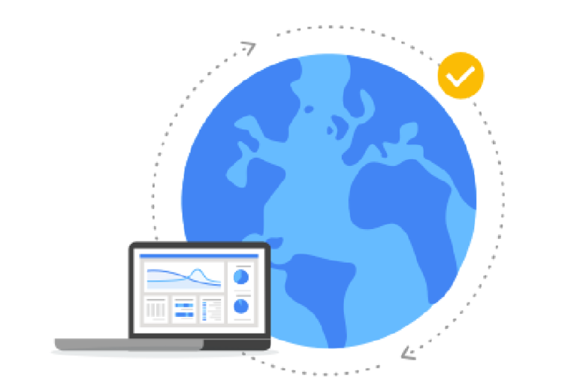
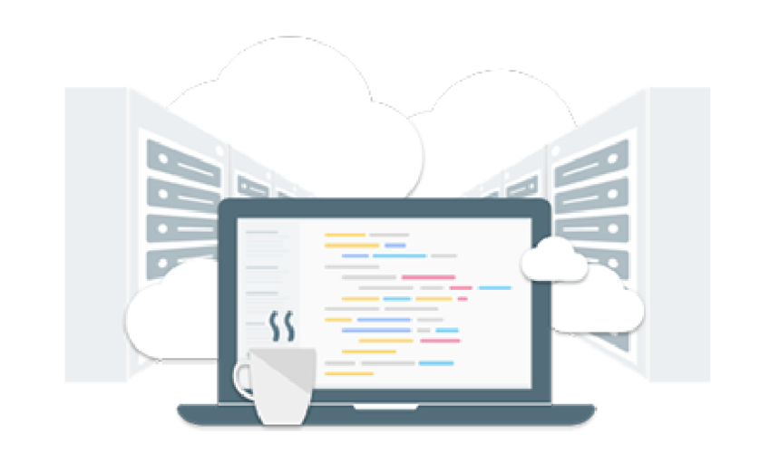
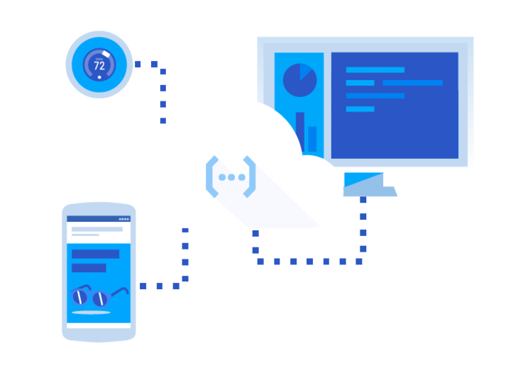
The components that make Cloud Functions work
Connect and extend cloud services
Events and triggers
Serverless
Copyright Google LLC. For educational purposes in accordance with the terms of use set forth on the program Website.
Notes:
Cloud Functions provides a connective layer of logic that lets users write code to connect and extend cloud services. Users can listen and respond to a file upload to Cloud Storage, a log change, or an incoming message on a Pub/Sub topic. Cloud Functions have access to the Google Service Account credential and are therefore seamlessly authenticated with the majority of the Google Cloud services, such as Datastore, Cloud Spanner, Cloud Translation API, and Vision API.
Cloud events are things that happen in the cloud environment. These might be things like changes to data in a database, files added to a storage system, or a new virtual machine instance being created. Events occur whether or not users choose to respond to them. Users can create a response to an event with a trigger. A trigger is a declaration that they are interested in a certain event or set of events. Binding a function to a trigger allows them to capture and act on events.
Cloud Functions removes the work of managing servers, configuring software, updating frameworks, and patching operating systems. The software and infrastructure are fully managed by Google so that users just add code. Furthermore, provisioning of resources happens automatically in response to events. This means that a function can scale from a few invocations a day to many millions of invocations without any additional work for users.

Slide 41

How Cloud Functions works
Emit events
Invokes other services
Writes back
Cloud services
Cloud Functions
Other APIs
Responds to events
Copyright Google LLC. For educational purposes in accordance with the terms of use set forth on the program Website.
Notes:
Events happen all the time within a system, like file uploads to Cloud Storage, changes to database records, requests to HTTP endpoints, and so on. By writing code that runs in response to those events, Cloud Functions runs it while automatically managing any underlying infrastructure. Cloud Functions connects and extends cloud services with code so you can treat them as building blocks and adjust them as your needs change. You can also extend your application using a broad ecosystem of third-party services and APIs.
A cloud service emits some kind of event. This can be a Pub/Sub message, a change to a cloud storage object, or a webhook for example. The event kicks off a Cloud Function. The function can be written in Node, Python, or Go. The function can invoke other services, and write back the results. Building infrastructure is not required when leveraging Cloud Functions.

Slide 42
Agenda
Event Driven Programs with Cloud Functions
Lab: Cloud Functions: Qwik Start - Command Line
Containerizing and Orchestrating Apps with GKE
Lab: Kubernetes Engine: Qwik Start
Copyright Google LLC. For educational purposes in accordance with the terms of use set forth on the program Website.
Notes:
Now we’ll create a cloud function by completing another hands-on lab.

Slide 43
Lab Intro
Cloud Functions: Qwik Start - Command Line
Create, deploy, and test a cloud function using the Cloud Shell command line.
The lab can be found here.
Copyright Google LLC. For educational purposes in accordance with the terms of use set forth on the program Website.
Notes:
In this lab, we’ll create, deploy, and test a cloud function using the Cloud Shell command line.

Slide 44
Lab objectives
Create a simple cloud function.
Deploy and test the function.
View logs.
Copyright Google LLC. For educational purposes in accordance with the terms of use set forth on the program Website.
Notes:
By completing the lab, you’ll create a simple cloud function, deploy and test the function, and view logs.

Slide 45
Lab Intro
Cloud Functions: Qwik Start - Console (Alternative)
Create, deploy, and test a cloud function using the Cloud Console.
The lab can be found here.
Copyright Google LLC. For educational purposes in accordance with the terms of use set forth on the program Website.
Notes:
In this lab, we’ll create, deploy, and test a cloud function using the Cloud Console.

Slide 46
Lab objectives
Create a cloud function.
Deploy and test the function.
View logs.
Copyright Google LLC. For educational purposes in accordance with the terms of use set forth on the program Website.
Notes:
By completing the lab, you’ll create a cloud function, deploy and test the function, and view logs.

Slide 47
Agenda
Event Driven Programs with Cloud Functions
Lab: Cloud Functions: Qwik Start - Command Line
Containerizing and Orchestrating Apps with GKE
Lab: Kubernetes Engine: Qwik Start
Copyright Google LLC. For educational purposes in accordance with the terms of use set forth on the program Website.
Notes:
In this final topic, we’ll learn how to leverage Google Kubernetes Engine.

Slide 48
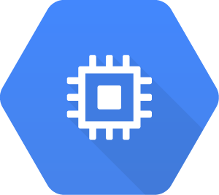
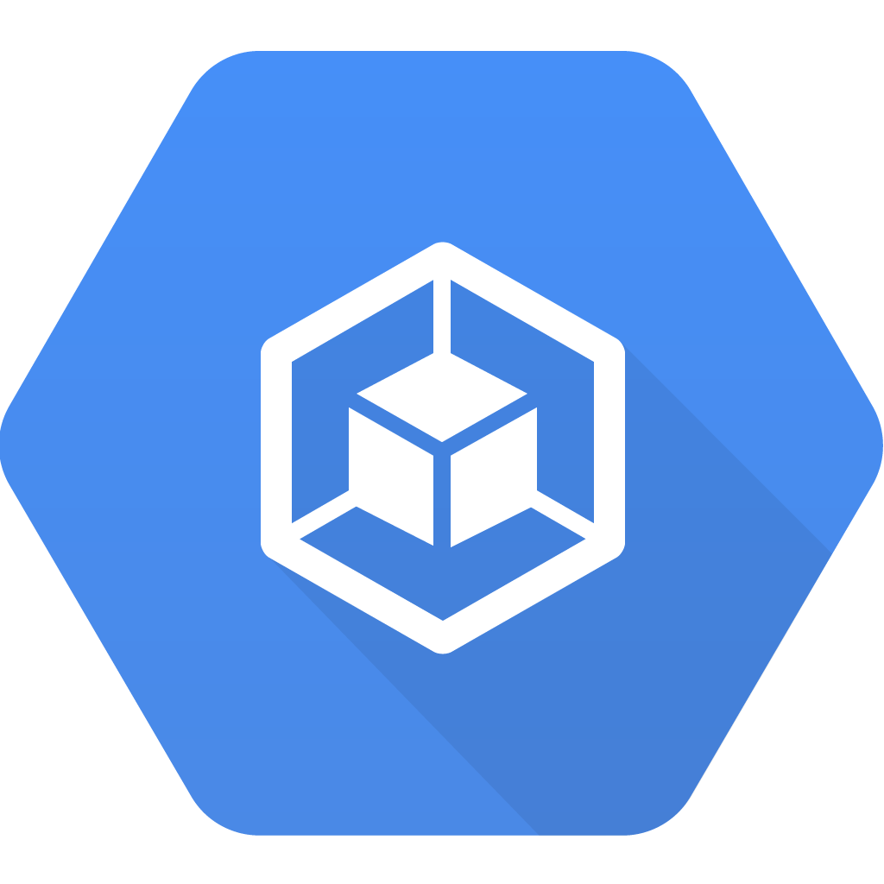
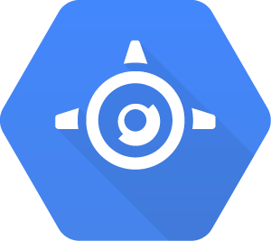
IaaS to PaaS comparison
Compute Engine
Google Kubernetes Engine
App Engine
IaaS
PaaS
Servers, networking, storage | Preset run-times, managed services
Pay for what you allocate | Pay for what you use
Copyright Google LLC. For educational purposes in accordance with the terms of use set forth on the program Website.
Notes:
We’ve already discussed the spectrum between infrastructure as a service and platform as a service. And we've already discussed Compute Engine, which is the IaaS offering of Google Cloud, with access to servers, file systems, and networking.
Now we'll introduce you to containers and GKE, which is a hybrid that conceptually sits between the two, offering the managed infrastructure of an IaaS, with the developer orientation of a PaaS offering.

Slide 49
Where GKE fits within Google Cloud
Compute Engine
App Engine
Cloud Functions
Google Kubernetes Engine
IaaS
PaaS
Serverless logic
Hybrid
Virtual machines with industry-leading price/performance
A flexible, zero ops platform for building highly available apps
A lightweight fully managed serverless execution environment for building and connecting cloud services
Cluster manager and orchestration engine built on Google’s container experience
Copyright Google LLC. For educational purposes in accordance with the terms of use set forth on the program Website.
Notes:
GKE is ideal for those that have been challenged when deploying or maintaining a fleet of VMs, and it’s been determined that containers are the solution. It’s also ideal when organizations have containerized the workloads and need a system on which to run and manage them, and don’t have dependencies on kernel changes or on a specific (non-Linux) operating system. With GKE, there’s no need to ever touch a server or infrastructure.
So how does containerization work?

Slide 50
IaaS virtualizes the hardware
App
App
App
Libs
Libs
Libs
OS
OS
OS
VMs
Hypervisor
Hardware
Copyright Google LLC. For educational purposes in accordance with the terms of use set forth on the program Website.
Notes:
Infrastructure as a service allows you to share compute resources with other developers by virtualizing the hardware using virtual machines. Each developer can deploy their own operating system, access the hardware, and build their applications in a self-contained environment with access to their own runtimes and libraries as well as their own partitions of RAM, file systems, networking interfaces, and so on.
You have your tools of choice on your own configurable system. So you can install your favorite runtime, web server, database, or middleware, configure the underlying system resources, such as disk space, disk I/O, or networking and build as you like.

Slide 51
Virtualizing the hardware costs time and resources
App
App
App
App
App
Lib
Lib
Lib
Lib
Lib
OS
OS
OS
OS
OS
Hypervisor
Hypervisor
Hardware
Hardware
Copyright Google LLC. For educational purposes in accordance with the terms of use set forth on the program Website.
Notes:
But flexibility comes with a cost. The smallest unit of compute is an app with its VM. The guest OS may be large, even gigabytes in size, and takes minutes to boot.
As demand for your application increases, you have to copy an entire VM and boot the guest OS for each instance of your app, which can be slow and costly.

Slide 52

Using PaaS provides hosted services and an environment that can scale workloads independently
Billing
Orders
Inventory
Write code in self-contained workloads and include any libraries.
Part1
Part2
Part3
Libs
Libs
Libs
Decouple code easily.
Services
Data | Cache | Storage | DB | Network
Copyright Google LLC. For educational purposes in accordance with the terms of use set forth on the program Website.
Notes:
With platform as a service, you get access to hosted programming services.
All you do is write your code in self-contained workloads that use these services and include any dependent libraries.
Workloads do not need to represent entire applications. They're easier to decouple because they're not tied to the underlying hardware, OS, or a lot of the software stacks that you used to manage.

Slide 53
The platform scales to meet demand
Build your apps as decoupled microservices.
P1
P2
P3
X
You may not be able to fine-tune the underlying architecture to save cost.
Services
Data | Cache | Storage | DB | Network
Copyright Google LLC. For educational purposes in accordance with the terms of use set forth on the program Website.
Notes:
As demand for your app increases, the platform scales your app seamlessly and independently by workload and infrastructure.
This scales rapidly and encourages you to build your applications as decoupled microservices that run more efficiently, but you won't be able to fine-tune the underlying architecture to save cost.

Slide 54
Leveraging containers offer the IaaS flexibility with PaaS scalability
App
App
App
containers
Libs
Libs
Libs
OS / Hardware
implements container interfaces
Copyright Google LLC. For educational purposes in accordance with the terms of use set forth on the program Website.
Notes:
That's where containers come in. The idea of a container is to give you the independent scalability of workloads in PaaS and an abstraction layer of the OS and hardware in IaaS.
It only requires a few system calls to create and it starts as quickly as a process. All you need on each host is an OS kernel that supports containers and a container runtime. In essence, you are virtualizing the OS. It scales like PaaS, but gives you nearly the same flexibility as IaaS.
Containers provide an abstraction layer of the hardware and OS, an invisible box with configurable access to isolated partitions of file system, RAM, and networking, as well as fast startup with only a few system calls.

Slide 55
Using a common host configuration, you can deploy hundreds of containers on a group of servers
MS2
MS1
MS3
Host1
Host2
Host3
Host4
Host5
Host6
Copyright Google LLC. For educational purposes in accordance with the terms of use set forth on the program Website.
Notes:
If you want to scale, for example, a web server, you can do so in seconds and deploy any number of containers, depending on the size of your workload, on a single host or group of hosts.
You'll likely want to build your applications using lots of containers, each performing their own function like microservices.
If you build them this way, and connect them with network connections, you can make them modular, deploy them easily, and scale independently across a group of hosts.
And the hosts can scale up and down and start and stop containers as demand for your app changes or as hosts fail.
With a cluster, you can connect containers using network connections, build code modularly, deploy it easily, and scale containers and hosts independently for maximum efficiency and savings.

Slide 56
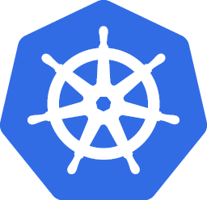

Kubernetes makes it easy to orchestrate many containers on many hosts
MS2
MS1
MS3
An open-source container management platform
Copyright Google LLC. For educational purposes in accordance with the terms of use set forth on the program Website.
Notes:
Kubernetes is a container orchestration tool you can use to simplify the management of containerized environments.
You can install Kubernetes on a group of your own managed servers or run it as a hosted service in Google Cloud on a cluster of managed Compute Engine instances called Google Kubernetes Engine.
Kubernetes makes it easy to orchestrate many containers on many hosts, scale them as microservices, and deploy rollouts and rollbacks.
It was built by Google to run applications at scale. Kubernetes lets you install the system on local servers in the cloud, manage container networking and data storage, deploy rollouts and rollbacks, and monitor and manage container and host health.

Slide 57
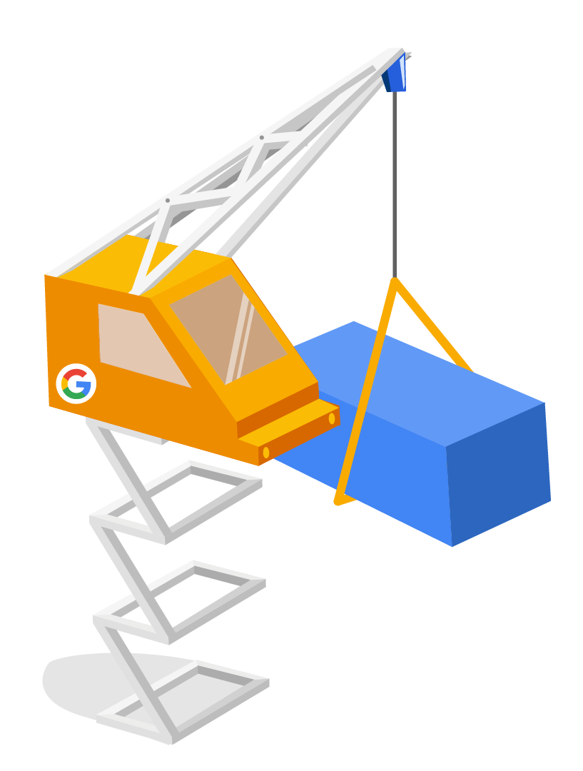
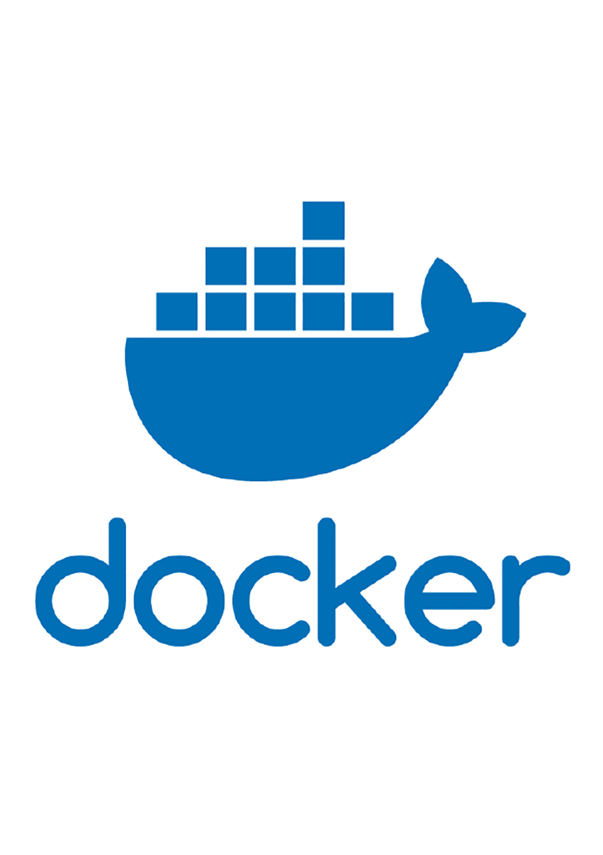
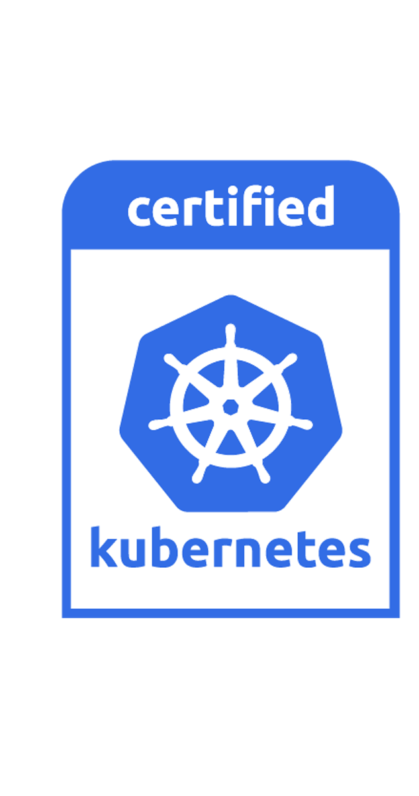
The relationship between containers, Docker,
and Kubernetes
Copyright Google LLC. For educational purposes in accordance with the terms of use set forth on the program Website.
Notes:
Just like shipping containers, a software container makes it easier for teams to package, manage, and ship their code. They write software applications that run in a container. The container provides the operating system needed to run their application. The container will run on any container platform. This can save a lot of time and cost compared to running servers or virtual machines. Like a virtual machine imitates a computer, a container imitates an operating system. Everything at Google runs on containers: Gmail, Web search, Maps, MapReduce, batch, Google File System, Colossus, even Cloud Functions (VMs in containers). Google launches over 2 billion containers per week.
Docker is the tool that puts the application and everything it needs in the container. Once the application is in a container, it can be moved anywhere that will run Docker containers—any laptop, server, or cloud provider. This portability makes code easier to produce, manage, troubleshoot, and update. For service providers, containers make it easy to develop code that can be ported to the customer and back.
Kubernetes is an open source container orchestration tool for managing a cluster of Docker Linux containers as a single system. It can be run in the cloud and on-premises environments. It’s inspired and informed by Google’s experiences and internal systems.

Slide 58
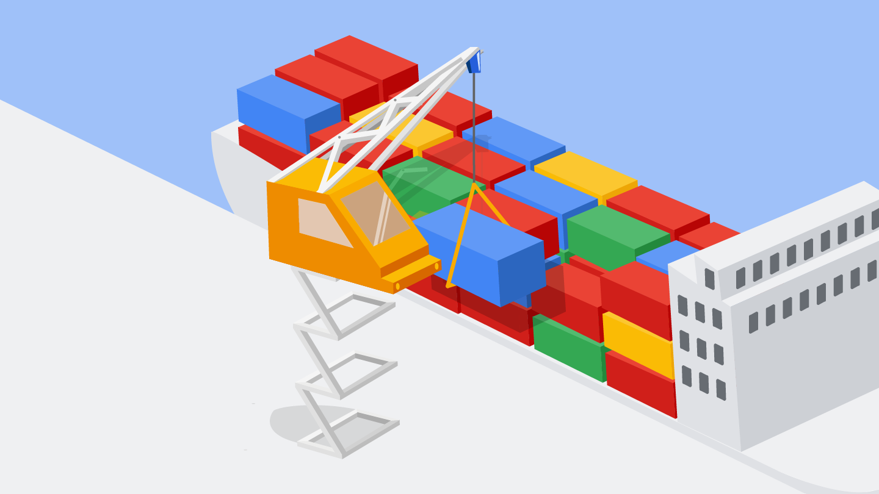
GKE is a managed environment for deploying containerized apps
Copyright Google LLC. For educational purposes in accordance with the terms of use set forth on the program Website.
Notes:
GKE is a managed environment for deploying containerized apps. It brings Google’s latest innovations in developer productivity, resource efficiency, automated operations, and open source flexibility to accelerate time to market. GKE is a powerful cluster manager and orchestration system for running Docker containers in Google Cloud.
GKE manages containers automatically based on specifications such as CPU and memory. It's built on the open-source Kubernetes system, making it easy for users to orchestrate container clusters or groups of containers. Because it’s built on the open source Kubernetes system, it provides customers the flexibility to take advantage of on-premises, hybrid, or public cloud infrastructure.

Slide 59
Agenda
Event Driven Programs with Cloud Functions
Lab: Cloud Functions: Qwik Start - Command Line
Containerizing and Orchestrating Apps with GKE
Lab: Kubernetes Engine: Qwik Start
Copyright Google LLC. For educational purposes in accordance with the terms of use set forth on the program Website.
Notes:
Now we’ll do a lab using GKE.

Slide 60
Lab Intro
Kubernetes Engine:
Qwik Start
Get hands on practice with container creation and application deployment with GKE.
The lab can be found here.
Copyright Google LLC. For educational purposes in accordance with the terms of use set forth on the program Website.
Notes:
In this lab, we’ll get hands on practice with container creation and application deployment with GKE.

Slide 61
Lab objectives
Set a default compute zone.
Create a GKE cluster.
Get authentication credentials for the cluster.
Deploy an application to the cluster.
Copyright Google LLC. For educational purposes in accordance with the terms of use set forth on the program Website.
Notes:
By completing the lab, you’ll set a default compute zone, create a GKE cluster, get authentication credentials for the cluster, and deploy an application to the cluster.

Slide 62
Agenda
Lab: Set Up Network and HTTP Load Balancers
Quiz
Summary
Copyright Google LLC. For educational purposes in accordance with the terms of use set forth on the program Website.
Notes:
We’ll now complete our final lab for this module, which focuses on network load balancers.

Slide 63
Lab Intro
Set Up Network and HTTP Load Balancers
Learn the differences between a network load balancer and a HTTP load balancer, and how to set them up for your applications running on Compute Engine virtual machines.
The lab can be found here.
Copyright Google LLC. For educational purposes in accordance with the terms of use set forth on the program Website.
Notes:
In this lab, we’ll learn the differences between a network load balancer and a HTTP load balancer, and how to set them up for your applications running on Compute Engine virtual machines.

Slide 64
Lab objectives
Set up a network load balancer.
Set up a HTTP(S) load balancer.
Differentiate between network load balancers and HTTP load balancers.
Copyright Google LLC. For educational purposes in accordance with the terms of use set forth on the program Website.
Notes:
By completing the lab, you’ll set up a network load balancer and a HTTP(S) load balancer, and learn to differentiate between network load balancers and HTTP load balancers.

Slide 65
Agenda
Lab: Set Up Network and HTTP Load Balancers
Quiz
Summary
Copyright Google LLC. For educational purposes in accordance with the terms of use set forth on the program Website.
Notes:
Finally, let's reinforce what we’ve learned with a quiz.

Slide 66
Scenario #1
Question
Which of the following would be considered IaaS?
Compute Engine
Google Kubernetes Engine
App Engine
Cloud Functions
Copyright Google LLC. For educational purposes in accordance with the terms of use set forth on the program Website.
Notes:
Which of the following would be considered IaaS?

Slide 67
Scenario #1
Answer
Which of the following would be considered IaaS?
Compute Engine
Google Kubernetes Engine
App Engine
Cloud Functions
Copyright Google LLC. For educational purposes in accordance with the terms of use set forth on the program Website.
Notes:
Compute Engine is an IaaS option. The hardware is managed for you, but you still have to manage your operating system and application.

Slide 68
Scenario #2
Question
Which of the following two services can take advantage of containers to run your applications?
Compute Engine
Google Kubernetes Engine
App Engine
Cloud Functions
Copyright Google LLC. For educational purposes in accordance with the terms of use set forth on the program Website.
Notes:
Which of the following two services can take advantage of containers to run your applications?

Slide 69
Scenario #2
Answer
Which of the following two services can take advantage of containers to run your applications?
Compute Engine
Google Kubernetes Engine
App Engine
Cloud Functions
Copyright Google LLC. For educational purposes in accordance with the terms of use set forth on the program Website.
Notes:
Both GKE and App Engine take advantage of containers to run applications.

Slide 70
Scenario #3
Question
Which of the following is considered to be serverless?
Compute Engine
Google Kubernetes Engine
App Engine
Cloud Functions
Copyright Google LLC. For educational purposes in accordance with the terms of use set forth on the program Website.
Notes:
Which of the following is considered serverless?

Slide 71
Scenario #3
Answer
Which of the following is considered to be serverless?
Compute Engine
Google Kubernetes Engine
App Engine
Cloud Functions
Copyright Google LLC. For educational purposes in accordance with the terms of use set forth on the program Website.
Notes:
Cloud Functions is serverless, event triggered code.

Slide 72
Agenda
Lab: Set Up Network and HTTP Load Balancers
Quiz
Summary
Copyright Google LLC. For educational purposes in accordance with the terms of use set forth on the program Website.
Notes:
That concludes the ‘Use Google Cloud to Build Your Apps’ module. Let me remind you of what you learned.

Slide 73
Summary
There are four different compute options in the Cloud to choose from: Compute Engine, App Engine, Cloud Functions, and Google Kubernetes Engine.
Compute Engine (an infrastructure as a service) delivers virtual machines via Google’s data centers and global fiber network.
Autoscaling controls managed instance groups.
App Engine is a computing platform provided as a service, allowing users to focus on writing code not on infrastructure.
Cloud Functions is a serverless option that connects and extends cloud services and automates with event-driven functions that respond to cloud events.
GKE is a hybrid between Compute Engine (IaaS) and App Engine (PaaS). It’s a managed environment for deploying containerized apps.
Copyright Google LLC. For educational purposes in accordance with the terms of use set forth on the program Website.

